Slide 1

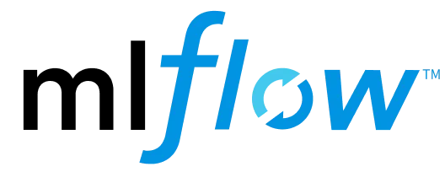
DAY-2 ( 21/04/2026) MLOps Workshop
Agenda :
Data & Experiment Management:
● Data
● MLflow / DVC
Hands-on: Track experiments using MLflow,Log parameters, metrics, models and Dataset versioning
- Varun Khare
M.Sc. Statistics, M.Tech. CSE ( NIT Jaipur )
Asst. Prof. AI&DS Dept., CMRIT

Slide 2
Challenges in Managing Machine Learning Experiments
Imagine running 10 ML experiments with different learning rates. After a week, it becomes difficult to remember which one performed best.
How do we organize, track, and manage machine learning experiments efficiently ???

Slide 3
Challenges in ML Contd…
Difficult to track multiple experiments and model versions
Hard to remember which hyperparameters produced the best results
Metrics like accuracy and loss are scattered across notebooks/files
No standard way to store trained models systematically
Reproducing results later becomes challenging
Collaboration between team members becomes confusing
Deployment-ready models are not easily identifiable

Slide 4
What is MLflow?
MLflow is an open-source platform for managing the machine learning lifecycle
Helps track experiments, parameters, metrics, and results
Stores trained models along with environment details
Supports multiple ML frameworks like PyTorch, TensorFlow, and Scikit-learn
Provides a web-based dashboard to compare experiments
Enables reproducibility and collaboration in ML projects
All of above means that MLflow helps us organize, track, and manage machine learning experiments efficiently.

Slide 5
Instead of manually writing results in notebooks, MLflow records everything automatically and shows comparisons in a dashboard.

Slide 6
Hands-On
https://github.com/azad712/MLFlow-demo.git

Slide 7
DVC (Data Version Control)
DVC was designed to solve a common machine learning problem:
Git works well for code, but not for large datasets and model files.
Open-source version control system for Data Science and Machine Learning projects.
Git-like experience to organize your data, models, and experiments.
https://dvc.org/

Slide 8
Why not use Git for datasets?
Git can track datasets, but it is not efficient for:
large files
frequently changing datasets
model checkpoints
Repositories become very large and slow.
DVC solves this problem.
Git tracks code, while DVC tracks corresponding datasets and models so machine learning experiments can be reproduced easily

Slide 9
Hands-On
https://github.com/azad712/MLFlow-demo.git

Slide 10
Complete Story
MLflow tracks experiments DVC tracks datasets Git tracks code

